Slide 1
Longest Common Subsequence

Slide 2
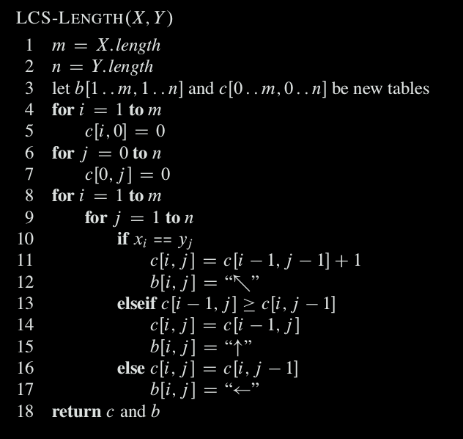
Step 3: Computing the length of an LCS

Slide 3
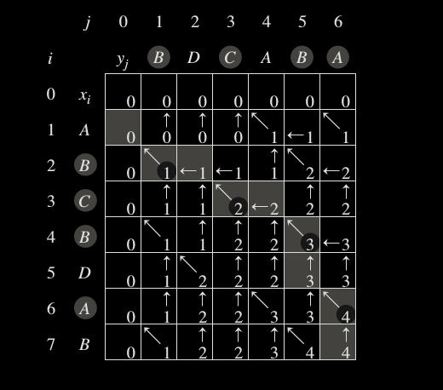
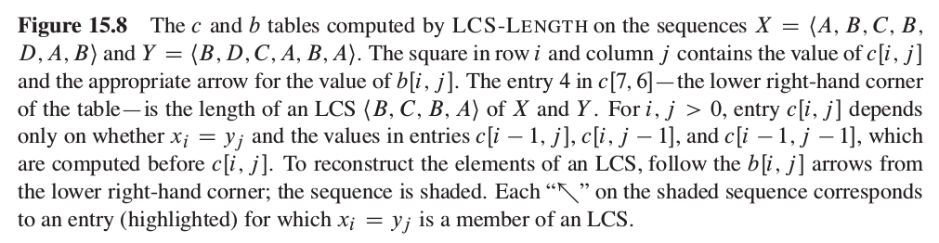

Slide 4


Slide 5
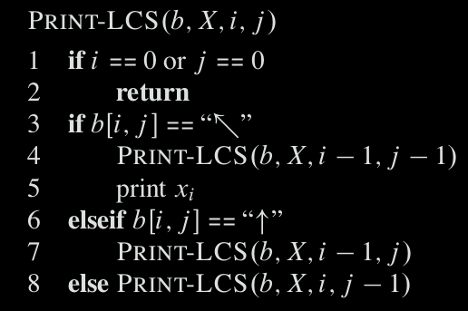
For the b table in Figure 15.8 this procedure prints BCBA The procedure takes time O(m + n) since it decrements at least one of i and j in each recursive call

